Slide 1
Machine Learning
Supervised Algorithms

Slide 2

Previous Day Recap
Duration - 2 minutes.
Interactive Discussion

Slide 3
Module Objectives
After completing this course you will be able to:
Explain what supervised algorithms are and some of the main approaches
List some of the main classification and regression algorithms
Understand concepts such as cost function and gradient descent
Describe how ensemble techniques work in general
Classify ensemble techniques and give examples for each class

Slide 4
Regression Analysis
Regression analysis is a collection of techniques mostly used in forecasting and prediction
Looks for cause and effect between independent and dependent variables:
Typically, a single dependent variable with continuous values:
Given x1, …, xn and y, we look for f such that f(x1, …, xn) approximates y
Methods differ on the number of independent variables and the type of relationship
Linear regression looks for a linear mapping
Univariate linear regression : only one independent variable
Multivariate linear regression : multiple independent variables
Non-linear regression
Polynomial, exponential, logarithmic, … (less common)
KNN, decision tree, random forest, …
Notes:
Prediction is concerned with estimating the outcomes on unseen data.
Forecasting is a sub-discipline of prediction in which we are making predictions about the future, on the basis of time-series data.
Sometimes, the term metric regression is used to indicate explicitly that we have one dependent variable with continuous values. However, often the term regression itself implicitly refers to metric regression, distinct from classification.
Multivariate linear regression is also known as general linear regression. Univariate linear regression is also known as simple linear regression.
Non-linear regression is less common. Some non-linear problems can be converted to the linear domain.

Slide 5
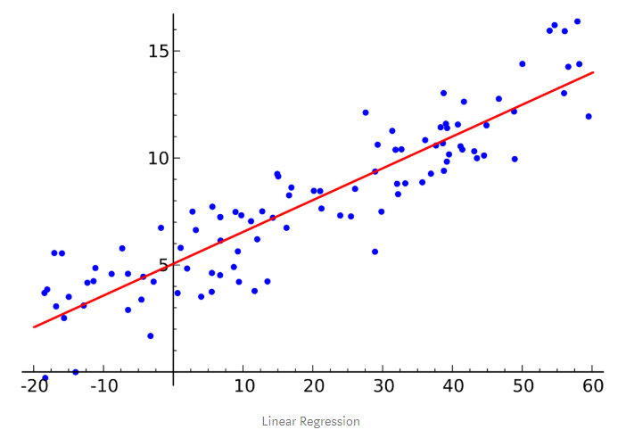
Linear Regression
Multivariate linear regression seeks a linear relationship f between x1, …, xn and y
It aims to predict parameters a0, …, an such that
f(x1, …, xn) = a0 + a1 x1 + … + an xn
Univariate linear regression is a special case with only one independent variable x:
f(x) = a x + b
The blue dots are the observations
The red line is the best fit straight line

Slide 6
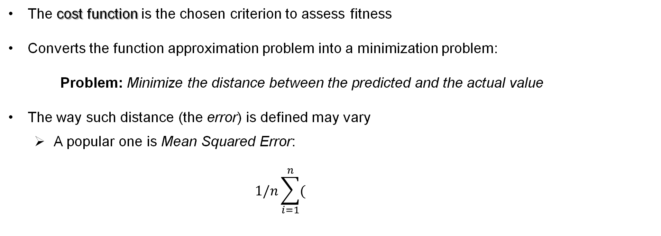
Cost Function
The cost function is the chosen criterion to assess fitness
Converts the function approximation problem into a minimization problem:
Problem: Minimize the distance between the predicted and the actual value
The way such distance (the error) is defined may vary
A popular one is Mean Squared Error:
$$1/n\sum_{i=1}^{n}{(}$$
predi - yi)
2

Slide 7
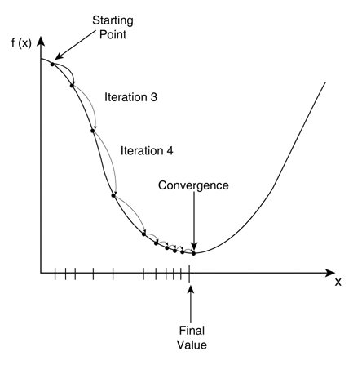
Gradient Descent
Having set the goal of minimizing the cost function, we need to find a way to get there
Gradient descent is the most popular technique to minimize the cost function in linear regression
We start by guessing the coefficients (e.g., a0 = v0, …, an = vn)
Then we iteratively tweak them until we find the minimal error

Slide 8
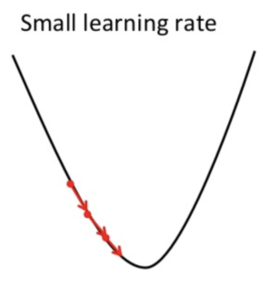
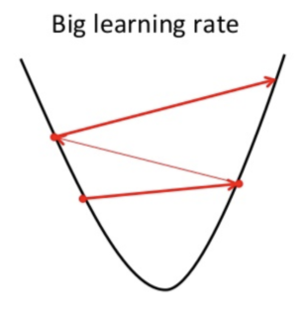
Choosing The Learning Rate
Beware! Small steps may take too long to complete …
… but big steps risk overshooting the bottom

Slide 9
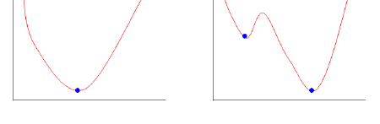
Gradient Descent in Non-Linear Techniques
Gradient descent can be applied to learning techniques other than linear regression
However, linearity guarantees that the cost function only has one minimum
That is not true in general
The risk is to get stuck in a local minimum which is not the global one

Slide 10
Linear Regression in Python
Import packages and classes:
Create model and fit it:
Get results:
from sklearn.linear_model import LinearRegression
model = LinearRegression().fit(x_train,y_train)
r_sq = model.score(x_valid, y_valid) a = model.coef_
b = model.intercept_
y_pred = model.predict(x_test)
Notes:
x can be a one- or two-dimensional array, y is typically one-dimensional. If x is two-dimensional, then a is one-dimensional and has as many elements as x has columns.
LinearRegression() creates an instance of a linear regression model. It accepts the following optional parameters:
fit_intercept is a Boolean (True by default) that decides whether to calculate the intercept 𝑏₀ (True) or consider it equal to zero (False).
normalize is a Boolean (False by default) that decides whether to normalize the input variables (True) or not (False).
copy_X is a Boolean (True by default) that decides whether to copy (True) or overwrite the input variables (False).
n_jobs is an integer or None (default) and represents the number of jobs used in parallel computation. None usually means one job and -1 to use all processors.
More info, here:
https://realpython.com/linear-regression-in-python/#implementing-linear-regression-in-python
And here:
https://scikit-learn.org/stable/modules/generated/sklearn.linear_model.LinearRegression.html#sklearn.linear_model.LinearRegression.fit
Wikipedia page for the coefficient of determination (r_sq above):
https://en.wikipedia.org/wiki/Coefficient_of_determination

Slide 11
Logistic Regression
Binomial classification aims to determine which of two classes an input belongs to
Logistic regression is a binomial classification technique
It looks for a function expressing a probability
The class is chosen based on whether the probability is closer to 0 or to 1
Example: Say if account is low or high risk, based on credit history, salary, …
Salary
Based on training set (star = high risk):
Give higher probability to bottom left entries
Progressively lower as we go right and up
High probability = high risk
Credit
quality
Notes:
NOTE: Despite the name, logistic regression does not belong to the realm of regression analysis.

Slide 12
Logistic Regression
Can we use linear regression to determine probability function?
NO! A linear function’s range can’t be contained in (0,1) interval
That makes the model too sensitive to outliers
Logistic regression uses a sigmoid function:
Prob. pass
1
.5
0
Hours of study
Prob. pass
1
.5
0
Hours of study
Notes:
Like we did for linear regression, it is possible to define a cost function for logistic regression.
We can then apply gradient descent or other, more advanced, methods to minimize the cost function. However, that is beyond the scope of this course.

Slide 13
Logistic Regression
The decision boundary can be represented by a straight line (sometimes):
Salary
Credit
quality
The red dashed line represents the 0.5 probability

Slide 14
Multinomial classification
Logistic regression can also be used for multinomial classification
We reduce the problem to multiple binomial classification problems:
We then have multiple probability functions
The one with highest probability determines the predicted class

Slide 15
Logistic Regression in Python
Import packages and classes:
Create model and fit it:
Get results:
from sklearn.linear_model import LogisticRegression
model = LogisticRegression().fit(x_train,y_train)
mean_acc = model.score(x_valid, y_valid) a = model.coef_
b = model.intercept_
y_pred = model.predict(x_test)
Notes:
model.predict(x) predicts class labels for samples in x.
model.score(x,y) calculates the mean accuracy. Accuracy is given by the number of correctly classified test samples over the total number of samples. Mean accuracy refers to the mean of all the accuracies calculated over several tests (e.g. if cross-validation is used). The coef_ and intercept_ attributes define the lines that separate the various classes (a single line in the case of binary regression).
More info on LogisticRegression(), here:
https://scikit-learn.org/stable/modules/generated/sklearn.linear_model.LogisticRegression.html

Slide 16
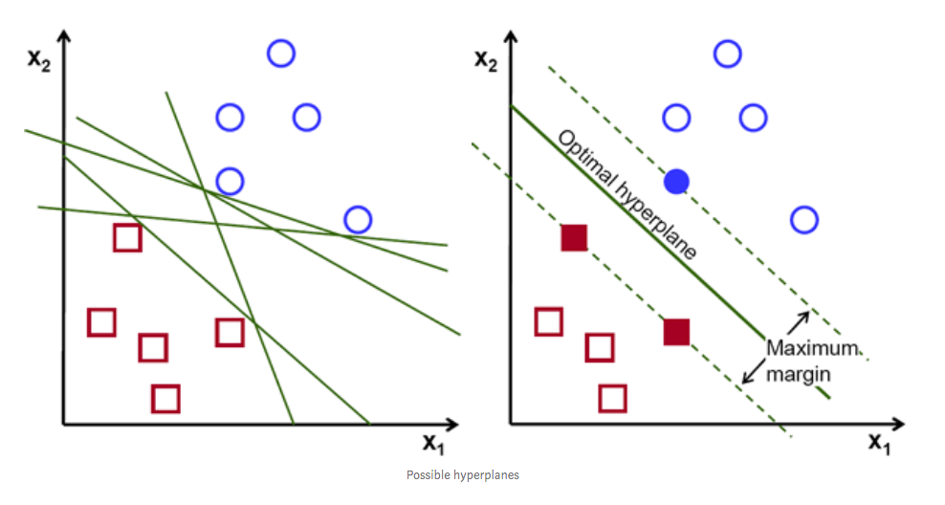
Support Vector Machines
Support Vector Machine (SVM) is a classification algorithm
It aims to maximize the linear margin between two classes
The support vectors are the points on the margin's borders

Slide 17
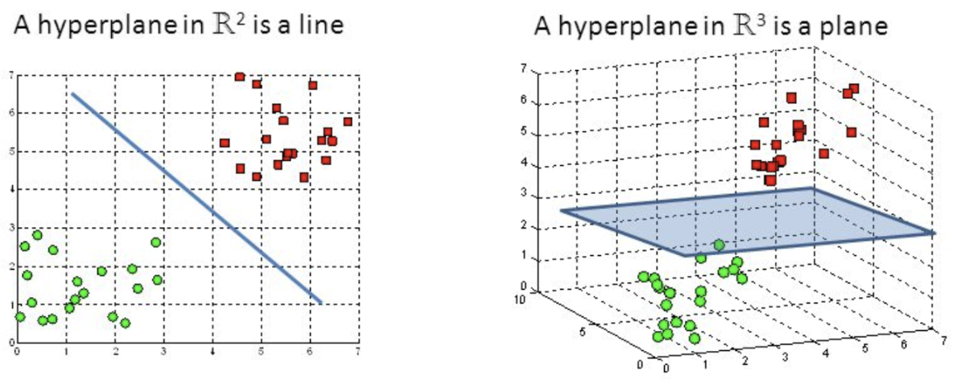
Support Vector Machines
The optimal hyperplane lies in the middle of the largest margin
It is called hyperplane because, in general, it isn’t a line
If the diagram is n-dimensional (n features), the hyperplane is (n-1)-dimensional
Notes:
NOTE: the hyperplane may not be always a line, but it is always linear: that means that it is not curved.

Slide 18
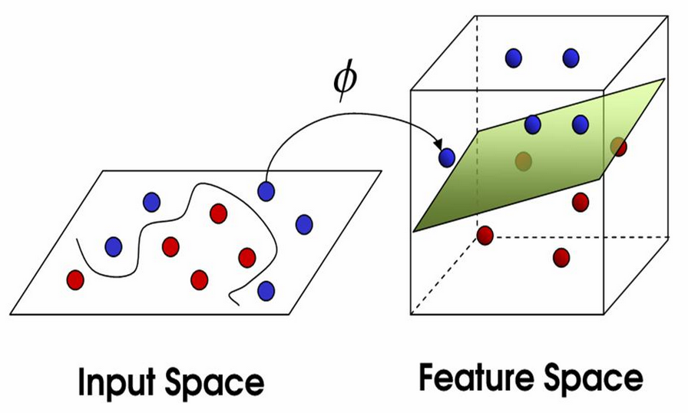
Support Vector Machines
In many practical cases, classes are not linearly separable
A solution consists in mapping the space to a higher dimension
A curved margin is mapped to a linear hyperplane in the higher dimensional space

Slide 19
Support Vector Machines
Higher dimensions require more computing power
Kernel trick: exploits projection in lower dimensions to reduce cost
Different kernel types: choosing the right one is not trivial
Alternative approach: replace hard margin with soft margin
Points from each class are allowed to be on the wrong side of the border …
… but that results in a penalty defined by a hinge loss function
The deeper a point is into "wrong territory", the higher the penalty
A cost function takes into account both border size and sum of penalties
The goal is to minimize the cost function
Notes:
Other issues with high dimensions are population sparsity and overfitting.
An issue with SVMs, in general, is that they do not directly support probability estimates.

Slide 20
Support Vector Machines in Python
Three classifiers available: SVC, NuSVC, LinearSVC
Import packages and classes (example with SVC):
Create classifier and fit it:
Get results:
from sklearn.svm import SVC
clf = SVC()
clf.fit(x_train,y_train)
support_vectors = clf.support_vectors_
n_vectors = clf.n_support_
Notes:
SVC and NuSVC are similar methods, but accept slightly different sets of parameters and have different mathematical formulations (see section Mathematical formulation). On the other hand, LinearSVC is another implementation of Support Vector Classification for the case of a linear kernel. Note that LinearSVC does not accept keyword kernel, as this is assumed to be linear. It also lacks some of the members of SVC and NuSVC, like support_.
As other classifiers, SVC, NuSVC and LinearSVC take as input two arrays: an array X of size [n_samples, n_features] holding the training samples, and an array y of class labels (strings or integers), size [n_samples]
More info on the svm package, here:
https://scikit-learn.org/stable/modules/svm.html
A tutorial on how to use it:
https://towardsdatascience.com/support-vector-machine-python-example-d67d9b63f1c8

Slide 21
Applications of Support Vector Machines
Medical classification tasks
Environmental analysis (e.g., air quality)
Image interpolation
Time series prediction
Financial analysis
Pattern recognition (e.g. fault diagnosis)
Page ranking

Slide 22
K-Nearest Neighbors
The K-Nearest Neighbors (KNN) algorithm can be used for both classification and regression
Classification: choose the most popular class among the K closest training examples
Regression: choose the average target value of the K closest training examples
KNN is an instance-based learning algorithm
It does not perform explicit generalization
It compares each new instance to examples seen in training
KNN is lazy
Classification is delayed until a query is made to the system
Similar to lazy execution

Slide 23
K-Nearest Neighbors
As a classification algorithm, KNN chooses the most popular class among K closest neighbors:
Salary
Salary
?
Credit
quality
Credit
quality
Notes:
NOTE: Despite the name, logistic regression does not belong to the realm of regression analysis.

Slide 24
K-Nearest Neighbors
The parameter K should be chosen carefully
If too small, choice may be affected by noisy data
If too big, choice may be overly affected by distant data points
Neighbors may be weighted, with weights inversely proportional to distance
The choice of a distance to determine proximity is also critical:
The Euclidean distance is a common choice for continuous values
The Hamming distance is common for discrete values (such as strings)
d(a.s, b.t) = d(s, t) + 1 (if a ≠ b) d(s, “”) = d(“”, s) = len(s)
d(a.s, b.t) = d(s, t) (if a = b)
Optimal distance can be learned algorithmically
Notes:
In the definition of the Hamming distance above: a and b are characters, while s and t are strings; . is the string concatenation operation and len is the function that returns the length of a string.
Other common distances include: Manhattan, Camberra, Minkowsky, Chebychev, …
Algorithms used to learn the optimal distance include: Neighbourhood Component Analysis and Large Margin Nearest Neighbor

Slide 25
K-Nearest Neighbors in Python
Import packages and classes:
Create classifier and fit it:
Get results:
from sklearn.neighbors import NearestNeighbors
knn = NearestNeighbors ( n_neighbors=5,
metric=‘euclidean’)
knn.fit(x_train, y_train)
indices, distances = knn.neighbors(x_train)
y_pred = knn.predict(x_test)
Notes:
indices and distances are two arrays which consist of lists of lists. Each inner list refers to one point and indicates the indices of (distances to, resp.) each one of the n neighbors of that point.
More info on the NearestNeighbor package, here:
https://scikit-learn.org/stable/modules/neighbors.html
https://scikit-learn.org/stable/modules/generated/sklearn.neighbors.KNeighborsRegressor.html#sklearn.neighbors.KNeighborsRegressor
A tutorial on how to use it:
https://towardsdatascience.com/k-nearest-neighbor-python-2fccc47d2a55

Slide 26
K-Nearest Neighbors
Advantages
Does not require prior knowledge about the distribution of the data
Does not require proper training and testing phase
Learns complex models easily
Robust to noisy data
Disadvantages
Computationally expensive
Need to compute distance from all training examples every time
Algorithms to approximate nearest neighbor search make it tractable
Many issues with high-dimensions:
Time and space requirements, data sparsity

Slide 27
K-Nearest Neighbors
Applications
Categorising text
Forecasting currency exchange rates
Forecasting bankruptcies
Understanding and managing financial risk
Managing loans
Profiling customers
Analysing health state of patients

Slide 28
Decision Tree
A decision tree is a tree-like model for decision-making
Each internal node represents a decision
Each branch represents a possible outcome for the decision
Each leaf node represents the class of objects characterized by the above decisions
When building a decision tree, we:
split the population into classes as we make decisions
continue the splitting process until we reach a predefined stopping criterion
predict based on the training examples from the same class
Decision trees can be used for both Classification And Regression:
Classification: the predicted value is the mode of the class
Regression: the predicted value is the mean of the class
Notes:
The decision trees that we use in machine learning are also known as Classification And Regression Trees (CART). This term is used to explicitly distinguish them from the decision trees used in other fields, such as decision analysis. The term “CART” also emphasizes the internal distinction between decision trees used for classification (classification trees) and decision trees used for regression (regression trees).

Slide 29
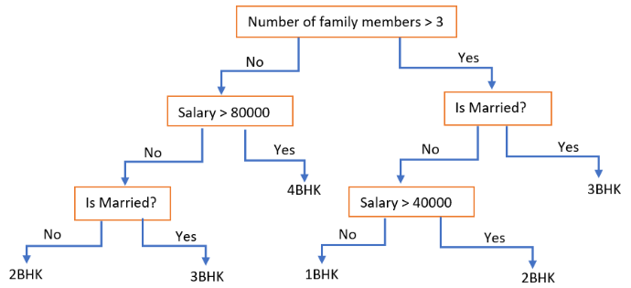
Decision Tree
Example: Decision tree to predict apartment type based on family size, salary and marriage status
Notes:
nBHK = n Bedrooms, 1 Hall, 1 Kitchen

Slide 30
Decision Tree in Python
Import packages and classes:
Create classifier and fit it:
Get results:
from sklearn.tree import DecisionTreeClassifier
dtc = DecisionTreeClassifier()
dtc = dtc.fit(x_train,y_train)
y_pred = dtc.predict(x_test)
class_prob = dtc.predict_proba(x_test)
Notes:
The predict method returns the index of the class with highest probability (for each point in x_test), whereas predict_proba returns the probability of each point to be in each class.
To use decision trees for regression, use the sklearn.tree.DecisionTreeRegressor package.
More info on the DecisionTree package, here:
https://scikit-learn.org/stable/modules/tree.html
Two tutorials on how to use it:
https://www.datacamp.com/community/tutorials/decision-tree-classification-python
https://towardsdatascience.com/decision-tree-in-python-b433ae57fb93

Slide 31
Decision Tree
Strategic choices of attributes and conditions to split on greatly affect accuracy
Some metrics are available to assess choices:
Gini impurity, Chi-square, information gain, reduction invariance
The choice may depend on the type of target variable
The stopping criterion is also very important
It could be based on the size of the resulting class
If not chosen correctly, it could lead to overfitting
To mitigate overfitting, several rounds of cross-validation may be applied
To correct it, pruning is needed

Slide 32
Decision Tree
Advantages
White box model (simple to understand, interpret and visualize)
Little data preparation required (feature and data selection are implicit in the algorithm)
Performs well with large datasets
Performance is not affected by non-linear relationships between parameters
Disadvantages
The tree structure is overly affected by small data variations
Unstable (repeated training iterations may yield very different outcomes)
Prone to overfitting and / or bias
Learning optimal tree is NP-complete (greedy algorithms required)
Greedy algorithms are used to select splitting conditions

Slide 33
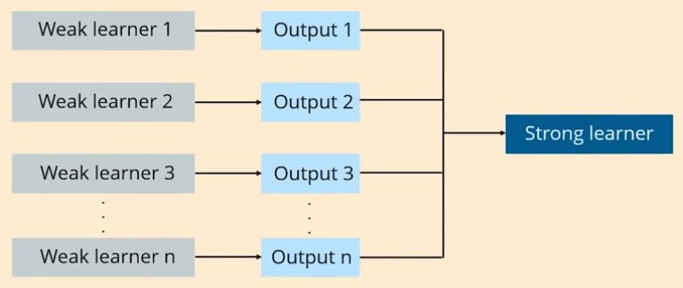
Ensemble Techniques
Ensemble techniques combine multiple models (learners) into one
Many weak and unstable learners are combined to produce a strong and robust learner
Compare this to big data processing in Hadoop
Do you see any similarity?
Notes:
Boosting tends to overfit the training data. Bagging is a simple and very common implementation that yields good results. Stacking is a sophisticated approach and possibly the best performer.

Slide 34
Ensemble Techniques
The aggregation of weal learners can be:
Homogeneous : single base learner is trained in different ways
Heterogeneous : different base models are used
Three main classes of ensemble techniques:
Boosting
learning sequentially and adaptively from homogeneous base models
results are averaged deterministically
Bagging
learning in parallel from homogeneous base models
results are averaged deterministically
Stacking
learning in parallel from heterogeneous base models
combiner algorithm takes others’ predictions as inputs
Notes:
NOTE! Base models and aggregation method must be chosen coherently:
- if base model has high variance, aggregation method should aim to reduce variance
- if base model has high bias, aggregation method should aim to reduce bias
Bagging techniques usually tend to reduce variance, while boosting and stacking tend to reduce bias.
Stacking techniques are more sophisticated and can potentially yield the best results. But they are also less commonly used than bagging and boosting, due to their complexity and the amount of resources they require. We will not cover stacking techniques in these slides
Main source:
https://towardsdatascience.com/ensemble-methods-bagging-boosting-and-stacking-c9214a10a205

Slide 35
Bagging
Bootstrap aggregating (or bagging) consists in training base models in parallel on different samples
We will focus on bagging applied to decision trees
Algorithm:
Repeat K times:
Sample, with replacement, n training examples from the input population
Train a decision tree on the sampled set
On unseen data, combine the predictions from each tree into a final prediction
A. Choose the mode for classification problems
B. Choose the mean for regression problems
Benefits: Decreases variance without increasing bias
Drawback: High correlation between trees when few features dominate
Notes:
Sampling with and without replacement (definition with example): https://web.ma.utexas.edu/users/parker/sampling/repl.htm
In the drawback: a feature is said to dominate when it has a high impact on the prediction. Then it is likely to be chosen early by each decision tree, potentially leading all trees to biased decisions, as they might all get stuck in local optima.
NOTE! Shallow trees tend to have high bias and low variance, while deep trees tend to have low bias but high variance. Bagging works best with deep trees, as it mainly focuses on reducing variance.

Slide 36
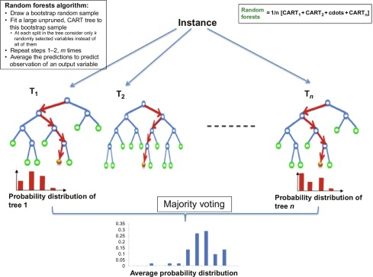
Random Forest
Random forest combines bagging with feature bagging
This comes down to the following modification to the tree learning algorithm:
At each candidate split in the learning process:
Sample a random subset of the features
Express a condition for the split only based on this subset of features
…
Notes:
Feature bagging is also known as the random subspace method and also as attribute bagging.

Slide 37
Random Forest in Python
Import packages and classes:
Create regressor and fit it:
Get results:
from sklearn.ensemble import RandomForestRegressor
rfr = RandomForestRegressor( n_estimators = 1000,
max_features = 10)
rfr.fit(x_train,y_train)
y_pred = rfr.predict(x_test)
tree = rfr.estimators_[5]
Notes:
The n_estimators parameter sets the number of trees in the forest. The max_features parameter is used to define the number of features to consider in each split of each tree.
The estimators_ attribute is a list of all the trees in the forest. Above, we save one tree, which could be visualized later.
More info on the RandomForestRegressor and the RandomForestClassifier packages, here:
https://scikit-learn.org/stable/modules/generated/sklearn.ensemble.RandomForestRegressor.html
https://scikit-learn.org/stable/modules/generated/sklearn.ensemble.RandomForestClassifier.html
Two tutorials on how to use them:
https://towardsdatascience.com/random-forest-in-python-24d0893d51c0
https://www.datacamp.com/community/tutorials/random-forests-classifier-python

Slide 38
Random Forest
Advantages
Maintains most of the advantages of a decision tree
Avoids overfitting and bias issues that affect single trees
No need for pruning
Reduces correlation between trees (compared to bagging)
Maintains accuracy for missing data
Disadvantages
Black box model
Harder to interpret than decision tree
Little control on what the model does
Lack of reproducibility

Slide 39
Random Forest
Applications
Assessing quality of scientific research
Predicting stock behavior
Predicting expected loss / profit
Predicting likelihood of customer buying recommended product
Image classification (e.g. body parts classification)
Optimizing combination of components for a medicine
Identifying disease by analysing medical records

Slide 40
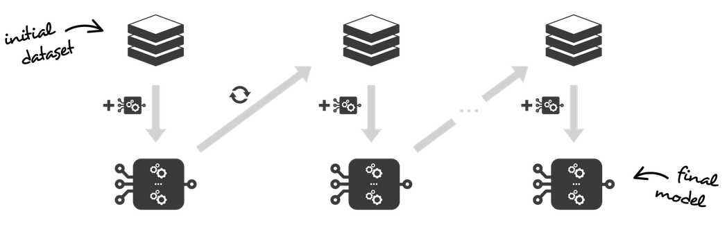


Boosting Techniques
Boosting is a sequential and adaptive ensemble technique:
Fitting of each base model depends on models fitted in previous iterations
Training data is incrementally altered to emphasize misclassified instances
Bias is progressively reduced by focusing on the hardest observations to fit up to now
We will be looking at three different boosting algorithms:
Gradient Boosting
XG Boost
CatBoost
Notes:
Note that, while the focus of boosting is on reducing bias, it can also have the effect of reducing variance.
“Being mainly focused at reducing bias, the base models that are often considered for boosting are models with low variance but high bias. For example, if we want to use trees as our base models, we will choose most of the time shallow decision trees with only a few depths. Another important reason that motivates the use of low variance but high bias models as weak learners for boosting is that these models are in general less computationally expensive to fit (few degrees of freedom when parametrised). Indeed, as computations to fit the different models can’t be done in parallel (unlike bagging), it could become too expensive to fit sequentially several complex models.” (https://towardsdatascience.com/ensemble-methods-bagging-boosting-and-stacking-c9214a10a205)

Slide 41
Gradient Boosting
Gradient Boosting aims to minimize some cost function in gradient descent fashion.
The algorithm does not specify what kind of weak learner and cost function to choose
Common choices are decision trees and Mean Squared Error
Algorithm:
INPUT: training set S, loss function L, number of iterations M
Initialize model F₀
For m = 1 to M:
Compute pseudo-residuals set R_{m} of F_{m-1} over S, using L
Fit a weak learner h_{m} on pseudo-residuals set R_{m}
Compute coefficient c_{m} minimizing loss function
Compute updated model F_{m} = F_{m-1} + c_{m}h_{m}
Apply F_{M} to new data
Notes:
For more details on the algorithm:
https://en.wikipedia.org/wiki/Gradient_boosting
https://medium.com/gradient-boosting-working-limitations-time/gradient-boosting-working-and-applications-28e8d4ba866d
https://explained.ai/gradient-boosting/index.html
Note that line 4 is the key step that sets Gradient Boosting apart from other boosting algorithms, such as AdaBoost. While in general boosting, the weak learners are fit directly on (some derivative of) the input set, in Gradient Boosting they are fit on the pseudo-residuals for the model that was computed in the previous iteration. This approach makes Gradient Boosting more easily adaptable to a larger number of loss functions.
Decision trees, aka CARTs (Classification And Regression Trees), are the weak learners of choice for Gradient Boosting. Since the optimization process is sequential, it could take a long time if the weak learners are themselves complex to compute. For this reason, CARTs used for Gradient Boosting are typically shallow (only a few nodes between the root and each leaf). By contrast, Random Forests may contain deep trees, since the computations are done in parallel.

Slide 42
XGBoost
XGBoost is an implementation of Gradient Boosting Decision Trees designed for performance
The name is short-hand for eXtreme Gradient Boosting
It is designed for speed and performance, which it achieves through a variety of features:
Parallelization of tree construction (with support for distributed computation)
Hardware optimizations (Out-of-Core Computing, cache awareness)
Tree-pruning (no stop criterion; uses max depth parameter & prunes backwards)
Regularization (it penalizes complex models to avoid overfitting)
Built-in cross-validation
Sparsity-awareness to deal with missing values
…
Notes:
Sources:
https://machinelearningmastery.com/gentle-introduction-xgboost-applied-machine-learning/
https://towardsdatascience.com/https-medium-com-vishalmorde-xgboost-algorithm-long-she-may-rein-edd9f99be63d
XGBoost library on GitHub:
https://github.com/dmlc/xgboost

Slide 43
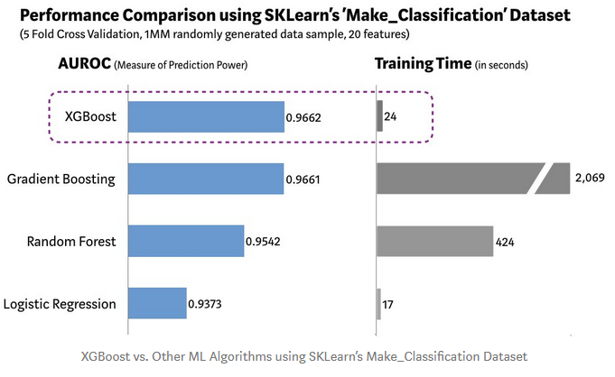
XGBoost
The following diagram shows how XGBoost performs compared to related methods:
Many other tests have been made, showing similar results
Notes:
Source:
https://towardsdatascience.com/https-medium-com-vishalmorde-xgboost-algorithm-long-she-may-rein-edd9f99be63d

Slide 44
CatBoost
CatBoost is a very efficient new GBDT implementation:
While training can take longer, prediction can be 8 to 16 times faster than other libraries
It works especially well with categorical features
Key features:
Symmetric trees
Nodes at each level use the same split
Ordered Target Statistic
It converts categorical features, while avoiding target leakage
Random permutations
Ordering data can give higher weight to some observations
Choosing random permutations for each learner fixes it
Combination of multiple categorical features into one
Notes:
Sources:
https://towardsdatascience.com/https-medium-com-talperetz24-mastering-the-new-generation-of-gradient-boosting-db04062a7ea2
https://medium.com/@hanishsidhu/whats-so-special-about-catboost-335d64d754ae
A symmetric tree is a tree where nodes of each level use the same split. This allows to encode path to leaf with an index. An example could be a tree with depth 2, where the split on the first level is f1<2, while the split on the second level is f2<4. This has two advantages: one is to decrease prediction time and the other is to reduce overfitting.
Target statistic is a method by which each categorical feature is encoded with the estimate of the expected target y, conditioned by the category. If this method is applied carelessly (e.g. by replacing a category with the average value of the target variable for that category), it leads to target leakage, which in turn influences the prediction (prediction shift).
Target leakage, also known as data leakage, “happens when you train your algorithm on a dataset that includes information that would not be available at the time of prediction when you apply that model to data you collect in the future. Since it already knows the actual outcomes, the model’s results will be unrealistically accurate for the training data, like bringing an answer sheet into an exam.” (https://www.datarobot.com/wiki/target-leakage/)
Ordered target statistic is an optimization of the target statistic approach introduced by CatBoost. It avoids target leakage by relying on an internal ordering of data. In this setting, the values of the training statistic for each example rely only on the history up to that point. As an example, consider the following toy dataset:
Day of week weather condition Max temperature
Sunday sunny 35
Monday sunny 32
Tuesday cloudy 15
Wednesday cloudy 14
Thursday mostly cloudy 10
Friday cloudy 20
Saturday cloudy 25
With naïve target statistic, we represent cloudy as (15+14+20+25) / 4 = 18.5. This leads to target leakage, because we are vectorising a data point using the target value for the same data point.
OTS vectorises all categorical features without target leakage. For example, on Friday cloudy would be represented as (15+14) / 2 = 15.5; while on Saturday it would be represented as (15+14+20) / 3 = 16.3. What about on Tuesday? In order to avoid the 0/0 problem, a constant is added.
Categorical feature combination makes sense, since in the real world, there are many different categorical features that can be represented as a single feature.

Slide 45
Gradient Boosting
Advantages
Gives the best predictions on average
Employed in winning projects of many Kaggle competitions
Widely employed in the industry as well (Yandex search engine)
Disadvantages
Tends to overfit if used carelessly
Hyper-parameter tuning using cross-validation takes time and efforts
Requires a lot of data for prediction accuracy
Takes longer time for training, especially when there are many features
Optimized variants (e.g. XGBoost, CatBoost) offer improvements
Is hard to interpret (black-box model), even more so than RF
Notes:
While GBDT implementations such as XGBoost and CatBoost are well known for offering the best performance in most applications, random forest is still preferred in situations where:
You want a solution that works better out-of-the-box
You are dealing with small datasets
Note that RF and GBDT can also be used together. For example, since RF is able to indicate the most important features, it may be used in a preliminary, feature selection phase, before the data is fed to some GBDT implementation for the actual training.

Slide 46
Module Review
What is linear regression and how does it work?
What is the purpose of classification analysis? List some approaches
What are SVMs and how do they work?
What is an ensemble technique? List pro’s, con’s and applications
What is Random Forest? Why is it popular?
List and compare different GBDT implementations

Slide 47
Module Outcomes
You should be able to:
Understand supervised learning and the problems that it solves
Perform linear and logistic regression
Compare SVMs, KNN and DTs and apply them to solve practical problems
Compare bagging, boosting and stacking
Understand how advanced GBDT implementations work and how they compare to RF

Slide 48
Questions

